Slide 1
GTFS configuration in GeoDMS
Chris Jacobs-Crisioni

Slide 2
Purpose
A stand-alone configuration (ie set of scripts and data) that is programmed to
Interpret GTFS structure files into a spatiotemporal, routable network
Combine multiple GTFS structure files for a study area
Generate origin-destination points for the study area (1km)
Generate GTFS-related accessibility indicators for any necessary spatial or temporal resolution
… all with maximum transparency and adaptability and minimum inputs. The downside is learning a bit of GeoDMS which may be a bit challenging.

Slide 3
Spatiotemporal network
Consists of:
Origin/destination points (only spatial relevance)
Scheduled links (from stop a @ time 1, to stop b @ time 2)
Waiting time at stop (from stop a @ time 1, to stop a @ time 2)
Transfers between stops (from stop a @ time 1, to all adjacent stops b…n @ time 1 + walking time)
Origin connection links (from origin @ starttime, to adjacent stop @ first departure available at or after starttime + walking time)
Destination connection links (from stop a @ time 1, to adjacent destination @ time 1 + walking time)

Slide 4
Spatiotemporal network {x,y,t} represented as {d,t}
Waiting at stop
Time ->
Destination
In transit
Walk to
destination
In transit
Stops transfer
Walk to stop
Origin
Distance ->

Slide 5
Restrictions imposed
Nodes are unique in space {x, y} and time {t}
Shortest path searches are unidirectional, thus can only go from {x1,y1,t1} to {x2,y2,t2}; not vice versa.
{x1,y1} may be {x2,y2} but t2 > t1.
Allowed is {x1,y1,t1} to {x2,y2,t2} to {x1,y1,t3}, although the travel cost will be equal to the waiting link {x1, y1, t1} to {x1, y1, t3}
Transfers are only allowed when explicitly defined through adjacence. The maximum euclidean distance of a transfer is managed through an adjustable parameter (currently 250m)
Origins/destination zones are connected at walking speed to all stops that meet an adjacency criterium, or, if that criterium does not yield a sufficient number N of connected stops per zone, the closest N stops. The minimum connected stops is managed through an adjustable parameter (currently 5 stops)

Slide 6
Spatiotemporal lingo
Stops: as defined in GTFS
Origins/destinations: as obtained from 1km grid
AllPlaces: Stops + Origins and destinations
Time: all seconds in a day
Scheduled: noted in relevant GTFS schedule
ScheduledLink: scheduled stop to stop movement
ScheduledTimeEvent: all moments existing globally in the relevant GTFS schedules
ScheduledSpaceTimeEvent: all moments existing at a specific stop in the relevant GTFS schedules
Static network: the part of the network that needs to be loaded regardless of starting time of a network analysis.

Slide 7
Vilnius as a case study
Set up as a first example
Municipality border as outline study area
One transport feed used
No walking times to transfers based on OSM data yet
Calculation: ~51 minutes for 288 times a 236 x 236 matrix (Stopwatch measurement on Intel i-7 6700k @ 4Ghz, 8 cores, 32Gb RAM)
Currently one indicator computed, potential accessibility, Ai = Sum(Pj*[tij^-1.5])

Slide 8
Getting started

Slide 9
Setting up the configuration
Download a recent version of GeoDMS (ran using 7.182) http://wiki.objectvision.nl/index.php/GeoDms_Setups
If necessary, download a text editor. Recommended: Notepad++ (see http://objectvision.nl/geodms/software/configuration-file-editor)
Set a practical folder division. My pc:
main.dms, main folder, on G:\ProjDir\GTFS\cfg (projdir)
_od_data, Vilnius, other feeds, on G:\SourceData\GTFS\data (datadir)

Slide 10
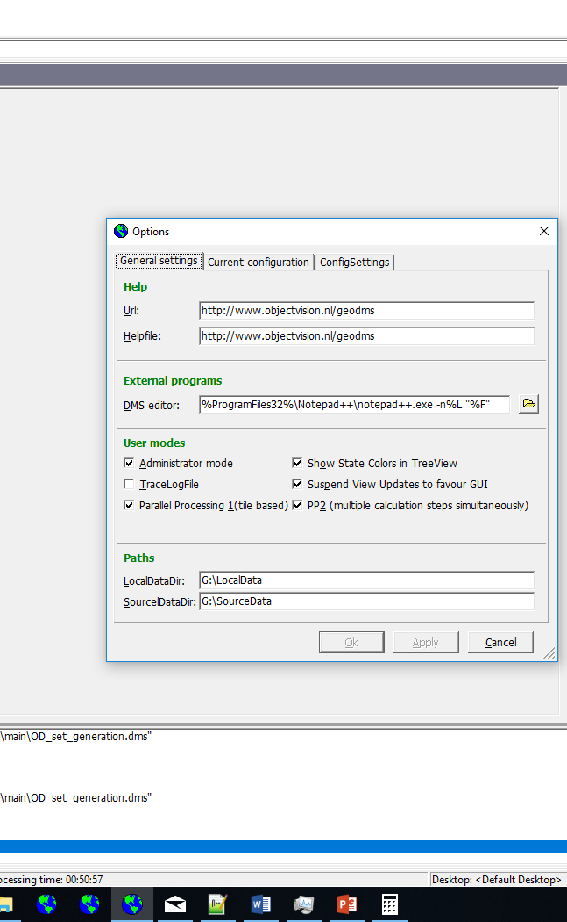
Configure GeoDMS
Start GeoDMS, go to options
Enable Administrator mode
Enable Parallel Processing 1 and PP2
Set LocalDataDir to the LocalData folder of a fast hard drive
Set SourceDataDir to where you put the GTFS\data folder (see prev slide)

Slide 11
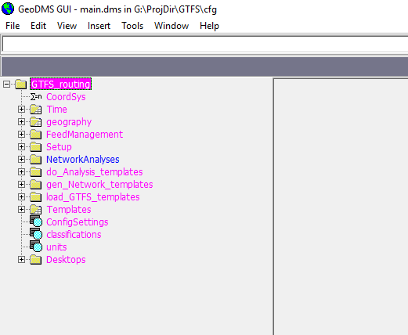
Open the configuration
File -> Open configuration file
Open main.dms in projdir
The result should be as to the right

Slide 12
Test the configuration
Go to /NetworkAnalyses/Vilnius_LT/NetworkResults/At_00h00m00s/Ai
Check if the item is purple, not red.
Double click to compute results.
If all is working, a map with accessibility values should pop up

Slide 13
Items in the configuration

Slide 14
Time
To pinpoint and track events occuring at a specific moment, time is expressed in integer units with a 1-second resolution. These units are defined formally as Time.
Currently Time has n=2d x 24h x 60m x 60s possible values (ie every second of a day, but not further than 0:00:00 – 23:59:59). So 0:00:00 = 0, 0:00:01 = 1, 0:01:00 = 60, 1:00:00 = 3600, etc.
Duration of a trip is computed as (arrival time) – (departure time). If departure time is larger than arrival time, n is added to arrival time.
So if a trip starts at 47:59:59 and ends after 48:00:01, duration is computed as (n + 1) – (23*59*59) = 2 (seconds).
Events scheduled with hours > 48 are reclassified as happening in the morning. Thus scheduled events at t=29:00:00 are considered happening at t=5:00:00. The duration of a trip between t=22:00:00 and t=5:00:00 is computed as (n + 5x60x60) - (22x60x60) = 25200 secs = 7 hours

Slide 15
Geography
Geography manages a number of items needed for spatial reference
Base manages the basic spatial unit (angles) and associated implications for visualization in the GUI
Cellsize_ manages angular size of grids projected at 100m or 1km
Grid_ offers standardized grids (fixed extent and resolution) to load into the project

Slide 16
Feedmanagement
Feedmanagement holds all the settings governing feeds and study area. When adding records in the dms file, do not forget to change the NrOfRows parameter for each changed table.
AvailableFeeds is set up as a library of feeds locally available on [SourceData/]data/[Name feed]
Study areas is set up to manage study areas. Each row represents a study area. A unique name is required. Studyarea_def indicates the unique municipality code in the LAU2 shapefile on [Sourcedata/]data/_od_data in the ICC_LAU_CO field
FeedsPerStudyArea is set up to provide, for each study area, all available feeds, so that they can be combined in the network setup.

Slide 17
Setup
In this section, the network is set up for performing shortest path analyses.
In parameters, relevant network generation characteristics are set explicitly
In LoadFeeds, all available GTFS feeds are loaded. The scheme allows for various dialects, although currently only a version compatible with the Vilnius feed is programmed.
In OD_set_generation, the study area is defined. Subsequently relevant bounding boxes for 1km and 100m population grids are loaded and 1km origin and destination sets are defined for the study area.
In StudyAreaFeeds, the data from all feeds relevant for a study area are combined.
In StaticNets, the “static” part of the network is created (ie without information from the first links Origin -> adjacent stops, as those are added only at the analysis section, when starting time is defined. This reduces redundant data.

Slide 18
Setup/Parameters (global)
Parameters: manages specific parameters that might be relevant for network generation and routing
MaxTransferDistKm: maximum euclidean distance of transfer between two stops
MaxODDistKm: maximum euclidean distance of connection from origin/destination to a stop
MinODConn: minimum amount of stops connected to an origin/destination
OD_time: internally relevant, sets the technical time for destinations
TransferEffectiveSpeed: assumed speed to overcome euclidean distance between two stops (and between origin/destination and stop if times are not obtained from OSM)

Slide 19
Setup/LoadFeeds/[AvailableFeed]
Loads the csv files and sets up the primary elements needed for routing. NOTE THAT GTFS FILES NEED TO RENAMED FROM .TXT TO .CSV SO GEODMS RECOGNIZES THEM AS STRUCTURED DATA FILES.
File_structure manages the files to be loaded for a specific feedtype
Stops turns the stop_lat and stop_lon variables into spatial information
Trips is currently unused (later necessary when calendar information is included)
TimesPerStop creates ScheduledLinks from the GTFS at hand

Slide 20
Setup/LoadFeeds/TimesPerStop
Converts arrival, departure, stop, ordinal information into time/space relevant information
Generates the lines between stops
Ordinal element indicates sequence of stops
Any link is thus made between the stop @ {trip, ordinal} and the stop @ {trip, ordinal + 1}
If no additional sequences are found (trip, ordinal + 1 = null), an end point is reached and no further links are searched for the trip at hand. This implies that the ordinal variable is neatly structured (without gaps), or scheduled links will be omitted.
ArrivalTime, DepartureTime convert time string info (hh:mm:ss) into an internal reference to the Time set (2*24*60*60 elements)

Slide 21
Setup/LoadFeeds/TimesPerStop (example)
Stop | Trip | Ordinal | Identifier | Link generated between spatial coordinates from identifiers:
X | A | 0 | {A, 0} | {A, 0} to {A, 1}
Y | A | 1 | {A, 1} | {A, 1} to {A, 2}
Z | A | 2 | {A, 2} | No link
X | B | 0 | {B, 0} | {B, 0} to {B, 1}
Y | B | 1 | {B, 1} | No link

Slide 22
Setup/OD_set_generation/[StudyArea]
Generates a set of spatial coordinates (with population counts) to use as origins and destinations
LAU2: loads shapefile containing all municipalities in EU
OD_Sets: loads, for any study area, the origin/destination set
Study_area_border selects the borders from the LAU2 shapefile that meet the criterium defined in FeedManagement/Study_Areas/Studyarea_def
Local1kmGrid defines the extent of a grid file that needs to be read
LocalPopGrid1Km loads the relevant extent of the EU GeoSTAT data
OD_points converts the grid to points. Currently only the geographical centre of grids is used. A method to take population-weighted centroids is foreseen, but encountered problems reading the grid used that is converted from the 100m grid to WGS84

Slide 23
Setup/StudyAreaFeeds/[StudyArea]
Combines the data relevant for routing from all feeds that are necessary for a study area
RelevantFeeds contains all feeds that are necessary for a study area
Stops is a combination of all stops in the study area
Links is a combination of all links in the study area

Slide 24
Setup/StaticNets/[StudyArea]
In this section, the static (ie not-changing) part of the network is generated for the entire study area, given
Some familiar parts: Stops (from StudyAreaFeeds), ODs (from OD_set_generation), ScheduledLinks (Links in StudyAreaFeeds)
CreateTransfersSet: creates connections between stops if they meet an adjacency (parameters/MaxTransferDistKm) criterion
CreateODConnections: creates connections between stops and O/D zones if they meet an adjacency (parameters/MaxODDistKm) criterium or the O/D zone meets (parameters/MinODconn) a minimum connectivity criterium.
StaticNet: the static part of the network, including the definite NodeSet
NodeSet: all unique modelled events {x,y,t}
WaitingAtStop: explicitly modelled waiting times between time events occurring at a stop

Slide 25
Setup/StaticNets/CreateTransfersSet
Creates direct lines between stops
SelectStopsForTransfers: makes a cartesian product of Stops x Stops, converts distances from WGS84 coordinates to meters using the Polar distance model, defines selection of stop-pairs with 0 < distance < max distance (MaxTransferDistKm)
TransferPaths: all selected stop-pairs
TransfersByTime: cartesian product of TransferPaths x ScheduledTimeEvents (all individual Time moments in which a departure or arrival takes place).
Used to seek departure times for transfer paths (matched with arrival times at origin stop of a transfer)
For seeking, the transfer paths for all relevant times are matched with scheduled moments per stop (so that transfers are only defined if a time event happens as an arrival at the origin stop of the transfer)
TransfersByStart: all the transfer paths by relevant starting time at the origin-stop
Duration of a transfer is defined by the computed length of a link and the effective walking speed on that link set in parameters/TransferEffectiveSpeed (in km/h).
End time of a transfer is defined as starting time + duration on the link. This creates additional time events on the stop.

Slide 26
Setup/StaticNets/CreateODConnections
Creates connections between O/D zones and Stops.
Connections from stops to destination zones are generated (from origin zones to Stops only in a later stage)
Works the same way as transfers, except:
For ODpaths, connections to stops are summed per zone. All connections that are maximally parameters/MaxODDistKm long are selected. If a zone has less than parameters/MinODconn connections to stops, the minimum number of closest stops is selected.
ODPathsByStart selects all connections of which departure time from stop coincides with arrivaltime at the stop. Duration is currently defined through effective speeds over an euclidean distance; in a later stage this can be replaced with travel times over the OSM network. Time of arrival at the destination is not relevant as the trip is over from there.
NOTE: Currently both origins and destinations are coded at time = 0. I need to check if there is the possibility that trips ‘reset’ their times by passing a destination, and then continue at an earlier convenience. The effects on total trip duration may be limited, but no guarantee and this would not throw an error. Maybe I need to define origin points on separate times as destination points, without the possibility of waiting at the destination (NodeSet needs to be redefined then as part of the total net)..

Slide 27
Setup/StaticNets/allLinks
AllLinks: all links except for waiting times, which are technically links but have the same origin and destination {x,y}

Slide 28
Setup/StaticNets/allLinks/uniqueStopXMoment
All {x,y,t} events from stops, including the additional times provided by transfers terminating in a stop
Sorted in such a way that the moments are first sorted by stop, then time, ascendingly, so that the next moment is picked up quite easily by going row further as long as the next row has the same stop reference
Used to generate WaitingAtStop

Slide 29
Setup/StaticNets/allLinks/WaitingAtStop
Generates ‘links’ between consecutive moments at the same stop ({x1,y1,t1} to {x1,y1,t2}).
Duration of waiting is the time between t2 and t1. The same 24-hour limit condition applies.
Travellers can wait between one arrival and one departure, and can skip several arrivals and departures. Whatever yields the shortest path.

Slide 30
Setup/StaticNets/Static_Net
Gathers all the relevant links, except the links from Origin to Stop
Creates a topology of links and a nodeset
Nodeset: unique occurences points {x,y,t}
Topology: managed through F1 (origin Node) and F2 (destination Node)
Duration: time spent to go from F1 to F2 (in seconds)

Slide 31
NetworkAnalyses
Here spatial analyses are executed based on the prepared network.
In MeasureMoments, all moments in time for which a measurement of variables is needed are being defined. This is currently based on Parameters/TemporalResolutionSec = 5 minutes, with a monotone rhytm. Alternatively random distributions can be applied with equal temporal resolution (ie 288 over a day).
In NetworkResults a network is completed for a specific starting time, an Odmatrix is generated and accessibility is computed
Note: adding additional indicators is quite easy here – just need some definitions
In AiResults the accessibility results for each measured moment are combined into one large dataset which is exported to a shapefile.

